Slide 1
Works in Translation Written Assignment
All the Nuts & Bolts

Slide 2
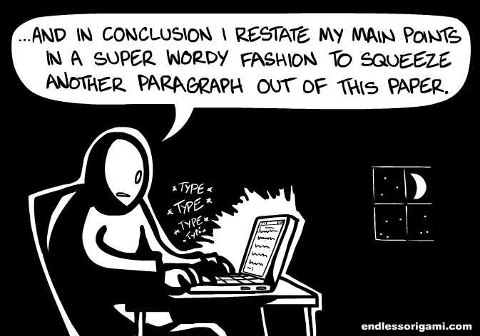
You are required to produce an essay of 1,200–1,500 words in length on a literary aspect of one work.

Slide 3
“The written assignment needs to grow out of the supervised writing” (Subject Report 2012)

Slide 4
Looking at the Supervised Writes
You will develop the essay with my guidance from one of the pieces of supervised writing completed in class.
From the ideas in the supervised writing, you must develop a topic and your final essay.
I must keep an unedited copy of the chosen supervised writing on file until the end of the examination session.
You will choose one of your pieces of supervised writing to develop into the essay required for submission.
There must be an apparent connection between the supervised writing and the final essay, but you are encouraged to provide your own title and to develop the chosen prompt in an independent direction.

Slide 5
Sample titles: Mrs. Linde as role model in A Doll’s House; The Vicario brothers as champions of honour; The contrasting roles of ice and snow in Dr. Zhivago

Slide 6
Boas’ Part In All This…
Guidance
Provide guidance on the development of the essay topic.
Discuss
Discuss the connections between the supervised writing and the essay.
Ensure
Ensure that the topic is suitable to the length and the focus of the task.
Read
Read the <first draft> of the essay and provide feedback to you. (I cannot annotate or edit your draft.)

Slide 7
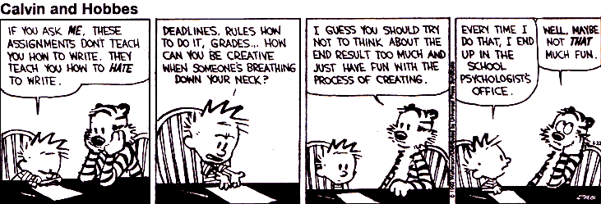
Completion of the essay for submission by the student:
After receiving feedback on the first draft, you must complete the written assignment without further assistance from the instructor.

Slide 8
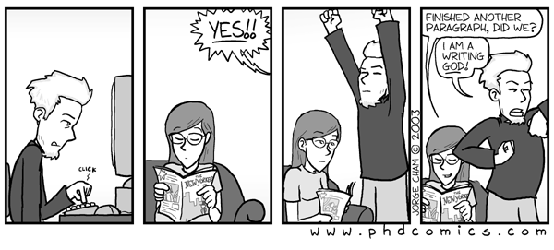
Notes from the IB gods…

Slide 9
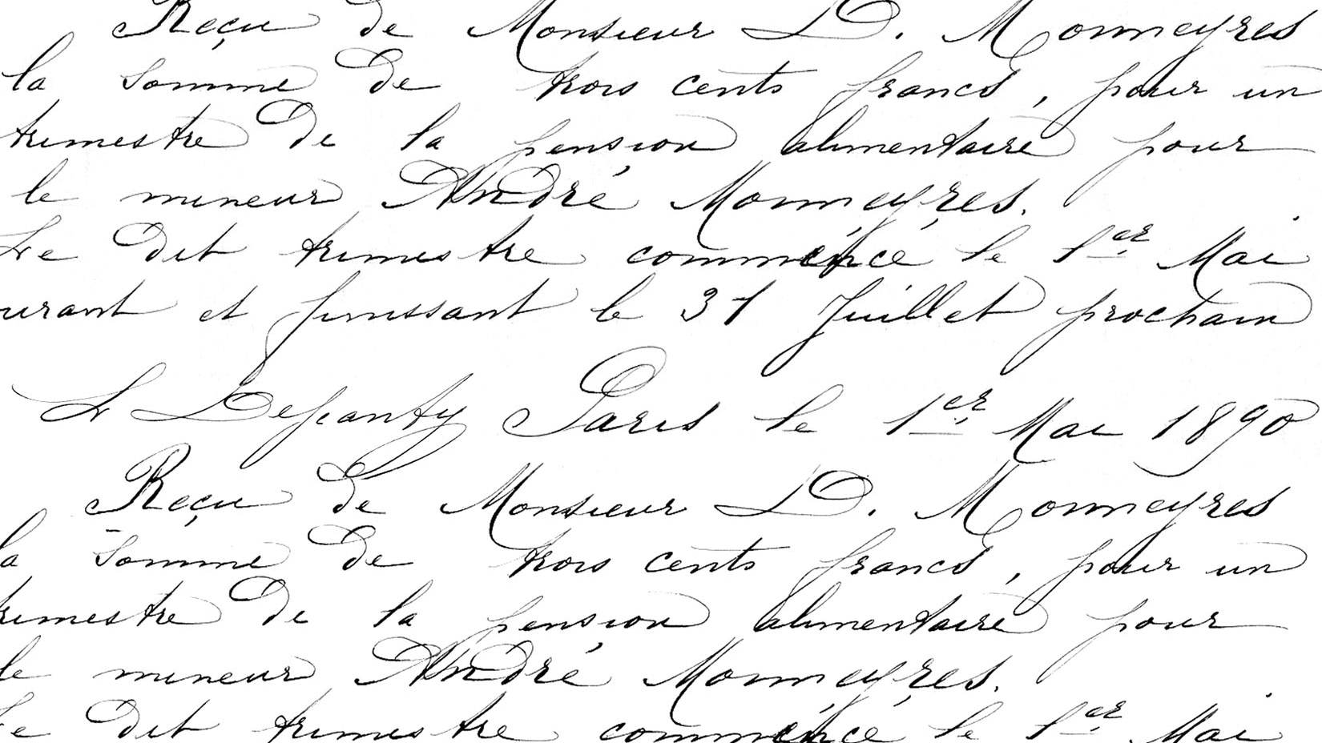
Regarding Quality of Work:
“ While writing an essay the candidate should have the book beside them so that they can give close references and quote accurately. Essays where characters‘ names are misspelt and events are misplaced are not acceptable in coursework.”

Slide 10
Regarding Pet Peeves of the IB gods:
“ Increasingly candidates from some centres describe characters from older literature using modern popular psychological terms. Aeschylus was not setting out to show that Medea was a dysfunctional mother and nor was Kafka suggesting that Gregor was seeking closure when he dies. Candidates seem to love using biographical information and relating it to a text. At times this may be relevant but often it is a distraction that hinders the proper understanding of a work.”
[In other words, do not use modern phrases for a work that was written in a different time in history!]

Slide 11
No biographical interpretation:
“…turning Gregor into a cockroach is not necessarily a consequence of Kafka’s relation to his father.
Inclinations in this direction are common at this level, but candidates should be told how shaky their arguments in this vein are likely to be without the substantial research such an approach requires.”
Saying Mrs. Linde is Ibsen’s mother-in-law would be an example of this for our texts.

Slide 12
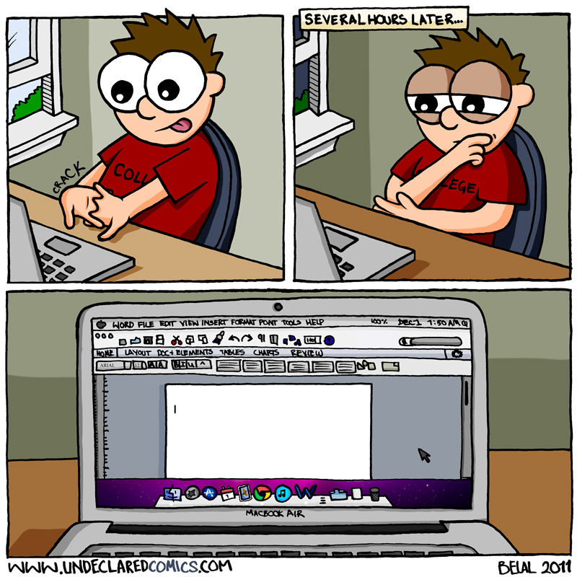
Address the issue of translation:
“Do address the issue of translation, and which elements in a work are likely to be less convincing when they are matters, such as aural features [auditory imagery], very much affected by this reality.”

Slide 13
Regarding Essay Structure:
“A good essay should have an introduction which guides the reader in to what to expect from the essay…
Introductions often contain a thesis which will form the centre of the argument in the essay.
The body of the essay should present an argument or provide an insight into the chosen aspect of the text.
It should contain detailed references to the text and integrated quotations.
The conclusion should synthesize the information and not just repeat what has already been stated.
Some candidates have a habit of telling the reader what the essay is about three times, each time adding a little more information. This is not a very successful technique as it is likely to lead to repetition and fragmentation…”

Slide 14
Regarding Proofreading:
“What does need more attention though is proof reading. Nowadays, when spell-checks are readily available, spelling mistakes are not acceptable.
Careful reading should pick up other technical errors.
Sometimes it seems that candidates have been encouraged to make use of a thesaurus. This is fine but candidates need to be told that not all synonyms can replace each other. Overuse can result in unintended connotations or in a pretentious, overblown or even incomprehensible syntax.”

Slide 15
Rubric Criterion…
…still more comments from the IB gods:

Slide 16
Knowledge & Understanding
“…Explicit address of the culture and context are the material of the preceding stages [I.O. and Reflective Statements]; they are not the business of the Written Assignment, except implicitly…”

Slide 17
Appreciation of the writer’s choices:
“Once again there [is] a clear dividing line between the majority of candidates who [can] identify some of the writer’s choices, and the minority who [are] able to show appreciation of the ways in which these choices [create] meaning.”
“The majority of papers tended to concentrate on theme or character; however, the focus on how techniques established these was not revealed.”
[clearly state the techniques, do not simply imply them]
[understand, and be specific in, your use of imagery]
“However, there were also some thoughtful analyses: candidates who select a thesis with a clear literary focus are likely to score well here.”

Slide 18
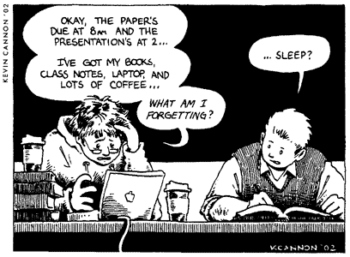
Organization and Development
“…many examiners comment on the clumsy incorporation of quotations into the body of the essays.”
[less is more]
[look at ALL implications of the idea/claim]

Slide 19
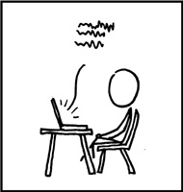
Language
“…clumsy sentence construction, lack of paragraphing, and really poor proofreading tend to appear much too often.”
“…weak punctuation and informal register were the most frequent causes for awarding a lower mark here.”
“Contractions should be avoided in formal academic writing.”
“Colloquial expressions and language that is not informed by an appropriate cultural/contextual sensibility cause disruption in terms of effective communication.”
[stay away from the thesaurus]
[use words that you know what they mean]

Slide 20
Your Supervised Writes
As you read through your Supervised Writes, take note of…
…how you answered the prompt. Did you develop ideas or is it simply popcorn thoughts?
…literary techniques – or at least ideas that can support a literary focused paper.
…insightful exploration of the text. Not simply re-hashing what we discussed in class.
…can you appreciate the author’s/poet’s writing choices by what you explored in this write?

