Slide 1
Tuesday’s Thoughts
January 31, 2017

Slide 2
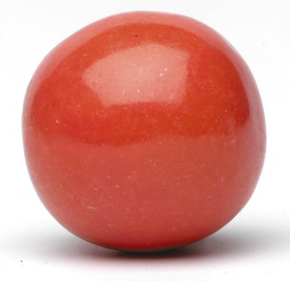
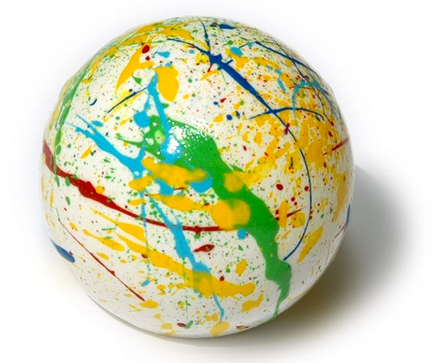
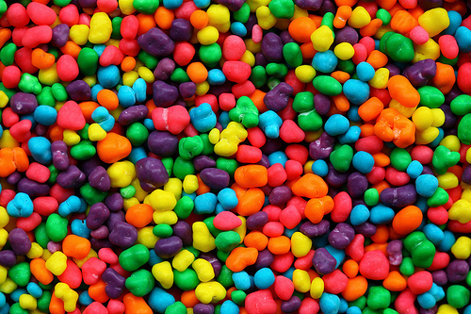
Jar = Life

Slide 3
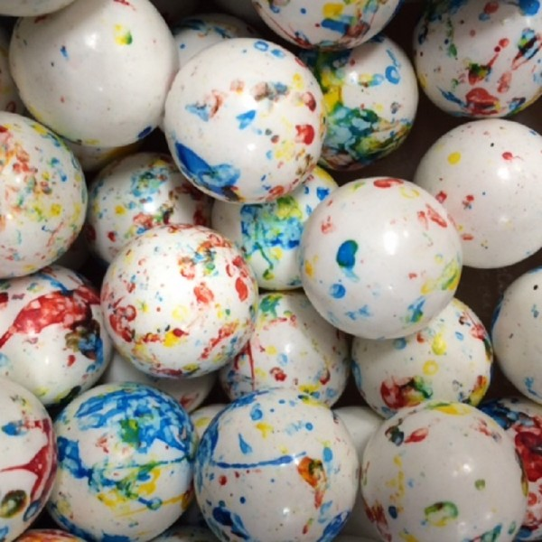
RELATIONSHIPS
Family
Friends
Passions:
What makes you unique
Dreams

Slide 4
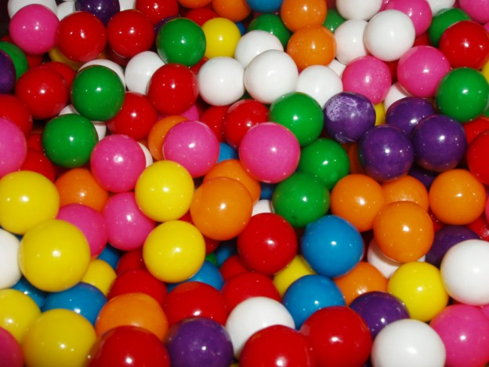
School
Responsibilities
Car
Community
Outreach

Slide 5
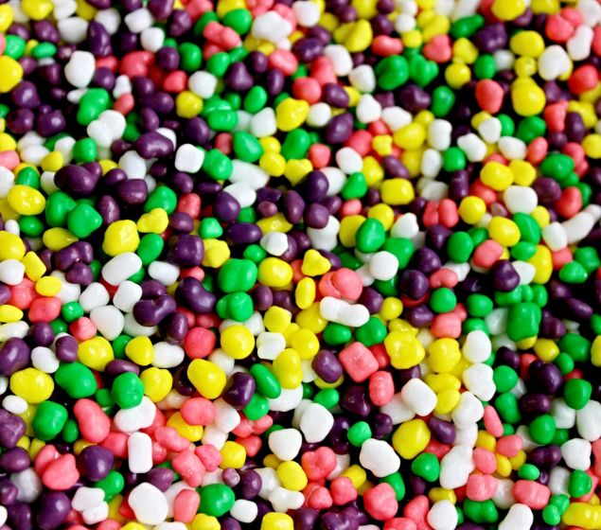
Distractions
Don’t fill your life with the small stuff!
Worries
Small
Stuff

