Slide 1
How Grateful Are you?
Monday Moment w/Mama Boas

Slide 2
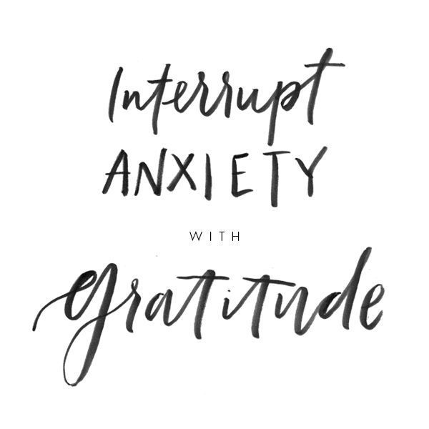

Slide 3
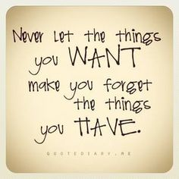
Habits of Grateful People
Number 1: Journal
I know, I know, “NO MORE WRITING!”
Research has shown that writing down what you’re thankful for can lead to a multitude of wellness benefits.
Keeping a gratitude journal can reinforce positive thoughts — something particularly helpful as the brain tends to naturally focus on what goes wrong.
Putting pen to paper can also help you make more progress as you work toward personal goals.
Simply 10 minutes a day can prove to be extremely beneficial.
It won’t come naturally – it is a discipline!

Slide 4
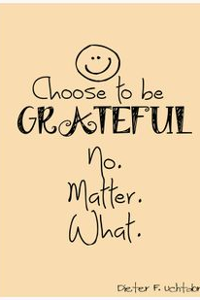
Number 2: Don’t Avoid the Negative
Gratitude does not come from being optimistic about everything.
Appreciation comes when you are able to look back and see how every step of the journey helps you become who you are!

Slide 5
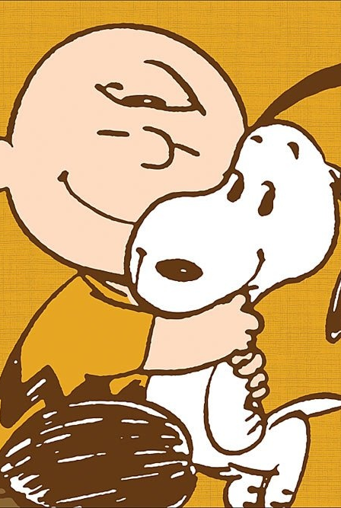
Three: Spend Time with Loved Ones
Thankful people know they didn’t get to where they are by themselves — and they make it a habit to spend time with those people who matter most.
“Gratitude really helps us connect to other people…It actually strengthens relationships and relationships are the strongest predictors of happiness and coping with stress” (Emmons).

Slide 6
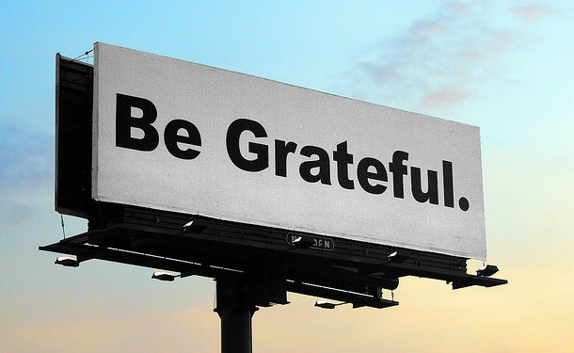
Number 4: Mindfully Use Social Media
In our plugged-in culture, it’s impossible to avoid social media altogether. However, Emmons says, thankful people mindfully take advantage of these networks.
“[Thankful people] use whatever cues that exist in everyday environments to trigger grateful thoughts,” he says. “Pictures and information on social media — that’s a very good way to do it.”
Research has found that positive thoughts shared on social media spread faster than negative — something that makes the gratitude process a lot easier when turning to the Internet.
Emmons suggests assembling an archive of postings on Facebook and Instagram to pull from when you need a reminder to be grateful.
This method will help you cue happy memories through pages that you normally visit on a daily basis.
“Technology and devices are criticized because you’re less connected, but if used correctly I think it can be the opposite,” Emmons said.

Slide 7
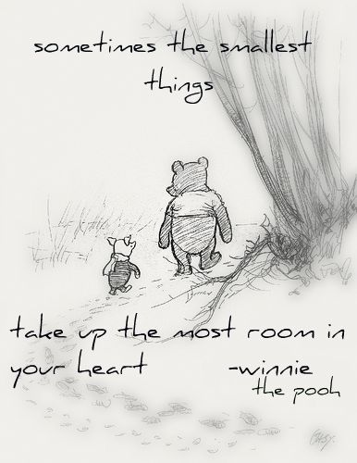
5: Know the Value of the Little Things
Small acts of kindness make a difference in a big way when it comes to cultivating gratitude.
Thankful people make it a habit to acknowledge and pay forward each bit of kindness that comes their way, whether it’s a simple compliment, help on a task or getting flowers “just because.”

Slide 8
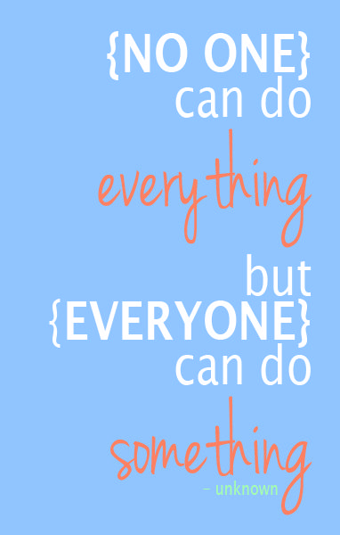
Number Six: Volunteer
Everyone needs a little help sometimes — and grateful people know there’s no other way to acknowledge this than by paying it forward.
…those who volunteer often feel grateful for the experience to give back. “Since service to others helped them to ﬁnd their own inner spirituality, they were grateful for the opportunity to serve…” (Emmons).
As recent research published in BMC Public Health points out, volunteering can result in lower feelings of depression and increased overall well-being.
Examine your own talents and use them to help others.
Remember that people become more grateful as givers rather than receivers.

Slide 9
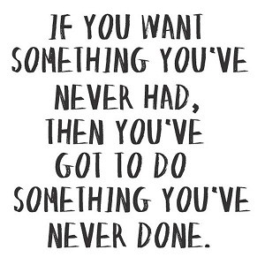
Number 7: Get Moving!
They may not seem similar, but gratitude and fitness can go hand-in-hand.
“…people who practice gratitude also engage in more exercise…”
Exercising has been proven to
clear your mind and
reduce stress…
Thankful people who move their feet experience an overall healthier mind and body, therefore making gratitude one of the best medicines.

Slide 10
Activity ☺

Slide 11
Being Grateful and Appreciative
You need a piece of paper and something to write with.
When you receive your candy – DON’T EAT THEM YET!
Follow the instructions on the following slide.

Slide 12
For every red candy, write the name of someone who has helped you along the way.
01
For every orange candy, write the name of an item you own you’re grateful for.
02
For every yellow candy, pick up a “Thank You” note to give to someone – TODAY!
03
For every green candy, write down each skill you have that you are thankful for.
04
For every blue or purple candy, choose someone you are going to help this week.
05

