Slide 1
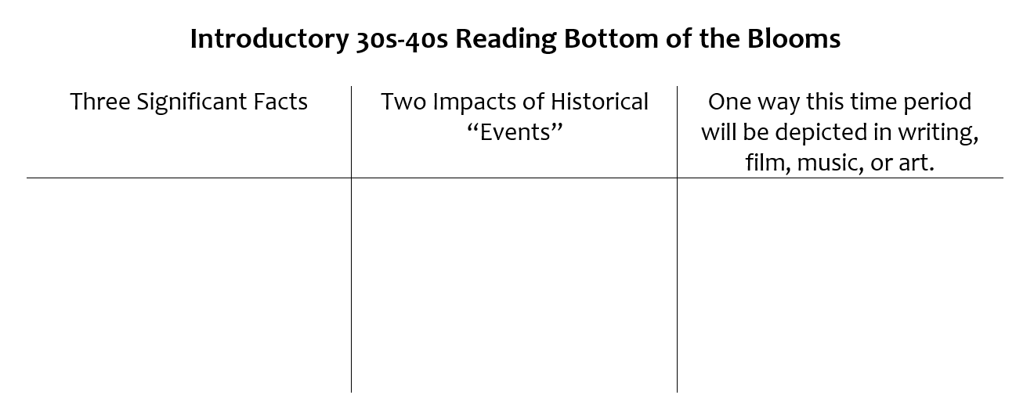
Friday, 3/8
Critical Reading Requirements:
As you read, mark the historical significance of what is on the page,
Ask any clarifying questions you have,
And look at how this information will effect the writers/artists/musicians/Hollywood at this time.
On your own piece of paper:
Create a Bottom of the Blooms Chart that mimics the example.
Draw a visual the depicts the information you have read.
Once you complete this assignment, have Ms. Boas stamp it and then the time is yours to work.

