Slide 1
Motivation
Please put your phones away.
Pick up your notebook from your folder.
Monday, November 13th

Slide 2
Why is Motivation so Important?
It’s the drive that helps us do what we need to do!
When you have a high level of motivation, you can accomplish a task quickly and efficiently.
When you’re feeling particularly unmotivated, though, finishing that same task can be extremely difficult and time-consuming.
When are some times that you felt highly motivated to do something?
How could increasing your level of motivation help you both now and in the future?

Slide 3
What Happens if You’re Not Motivated?

Slide 4
Everyone experiences a lack of motivation sometimes.
It’s normal to feel less motivated to do something you don’t like to do.
When are you the least motivated?
These are all normal and everyone goes through those up and downs with motivation.
Notes:
Examples might include cleaning your room, taking out the trash, or starting a really challenging report.
You might also feel less motivated to do something when you’re not feeling your best, especially if you are tired, sick, or just in a bad mood.

Slide 5
Having a lack of motivation can be a problem, though, if you are not finishing the task you need to do.

Slide 6
StudentA Example
Let’s say StudentA has a term paper due in two weeks.
The first few days maybe he’s/she’s not supermotivated because he was sick.
In after two days, StudentA can pull himself/herself together and start his/her term paper, things will probably be fine.
But what if StudentA never regains his/her motivation to start or finish the term paper?
That is when it could be very bad for StudentA.
He/she could score a 0%,
not get any extension from the teacher,
and possibly end up failing the entire class.
That is how a serious lack of motivation can be trouble.

Slide 7
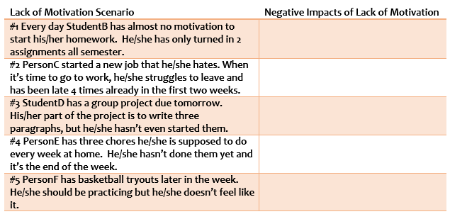
Review each scenario below. Identify how each person’s lack of motivation could negatively impact them. Consider what the consequences might be.

Slide 8
Eight Strategies for Motivation

Slide 9
Everyone need strategies to help boost their motivation.
Having ways to increase your motivation can help you get your tasks and responsibilities done.

Slide 10
1) Working Towards Your Goal
Know your own personal goal so you can work towards accomplishing it.
When you have a written goal, you are much more likely to achieve that aspiration.

Slide 11
2) Boosting Your Mood
You have to find ways to improve your mood in order to increase your motivation.
If you don’t feel your best, you’re more likely not to DO your best either.

Slide 12
3) Giving Yourself Incentives
Sometimes just giving yourself a small incentive, like time for a videogame, television show, or time with friends, can help you accomplish what you need to.
Giving yourself a reward is a simple thing to do.

Slide 13
4) Starting with Just 1 Thing
Sometimes getting started is the hardest part.
Make a list and choose just one thing to start.
Once you accomplish that, it will be much easier to keep going with your assignment or task.

Slide 14
5) Using Reminders & Cues
Give yourself reminders and cues that will help cue your brain to get going.
Reminders can be on paper, electronic, or even a verbal reminder by a parent or friend.

Slide 15
6) Not Letting Failure Derail You
It’s common to feel crumby if you don’t do well at something.
However, failure shouldn’t stop you from achieving your goals.
Find a way to “get over” your failure and move on to what you are working towards.

Slide 16
7) Staying Positive
Keeping a positive attitude and thinking pattern definitely helps you stay motivated.
Being negative really does the exact opposite.

Slide 17
8) Enjoying Your Success
Take time to feel good about completing your goals.
If you skip this step, you’ll never learn to be truly satisfied when you accomplish something.
It’s important!

